Slide 1
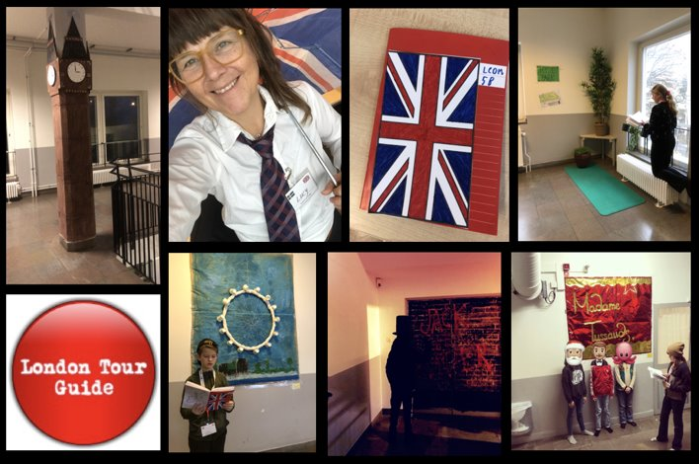

Hello,
It’s time to get to know The United Kingdom, England, London and some places of interest.
Your goal is to become a London Tour Guide. A group of students will follow you around London (at our school) and stop at different places to learn more about attractions such as The London Eye, Big Ben, Hyde Park and more.
Good Luck!
/Lucy
@lottabo_2025

Slide 2
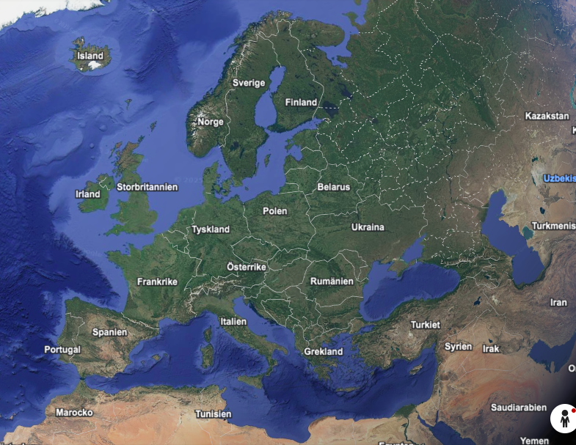
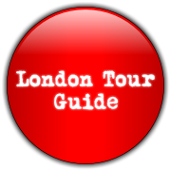
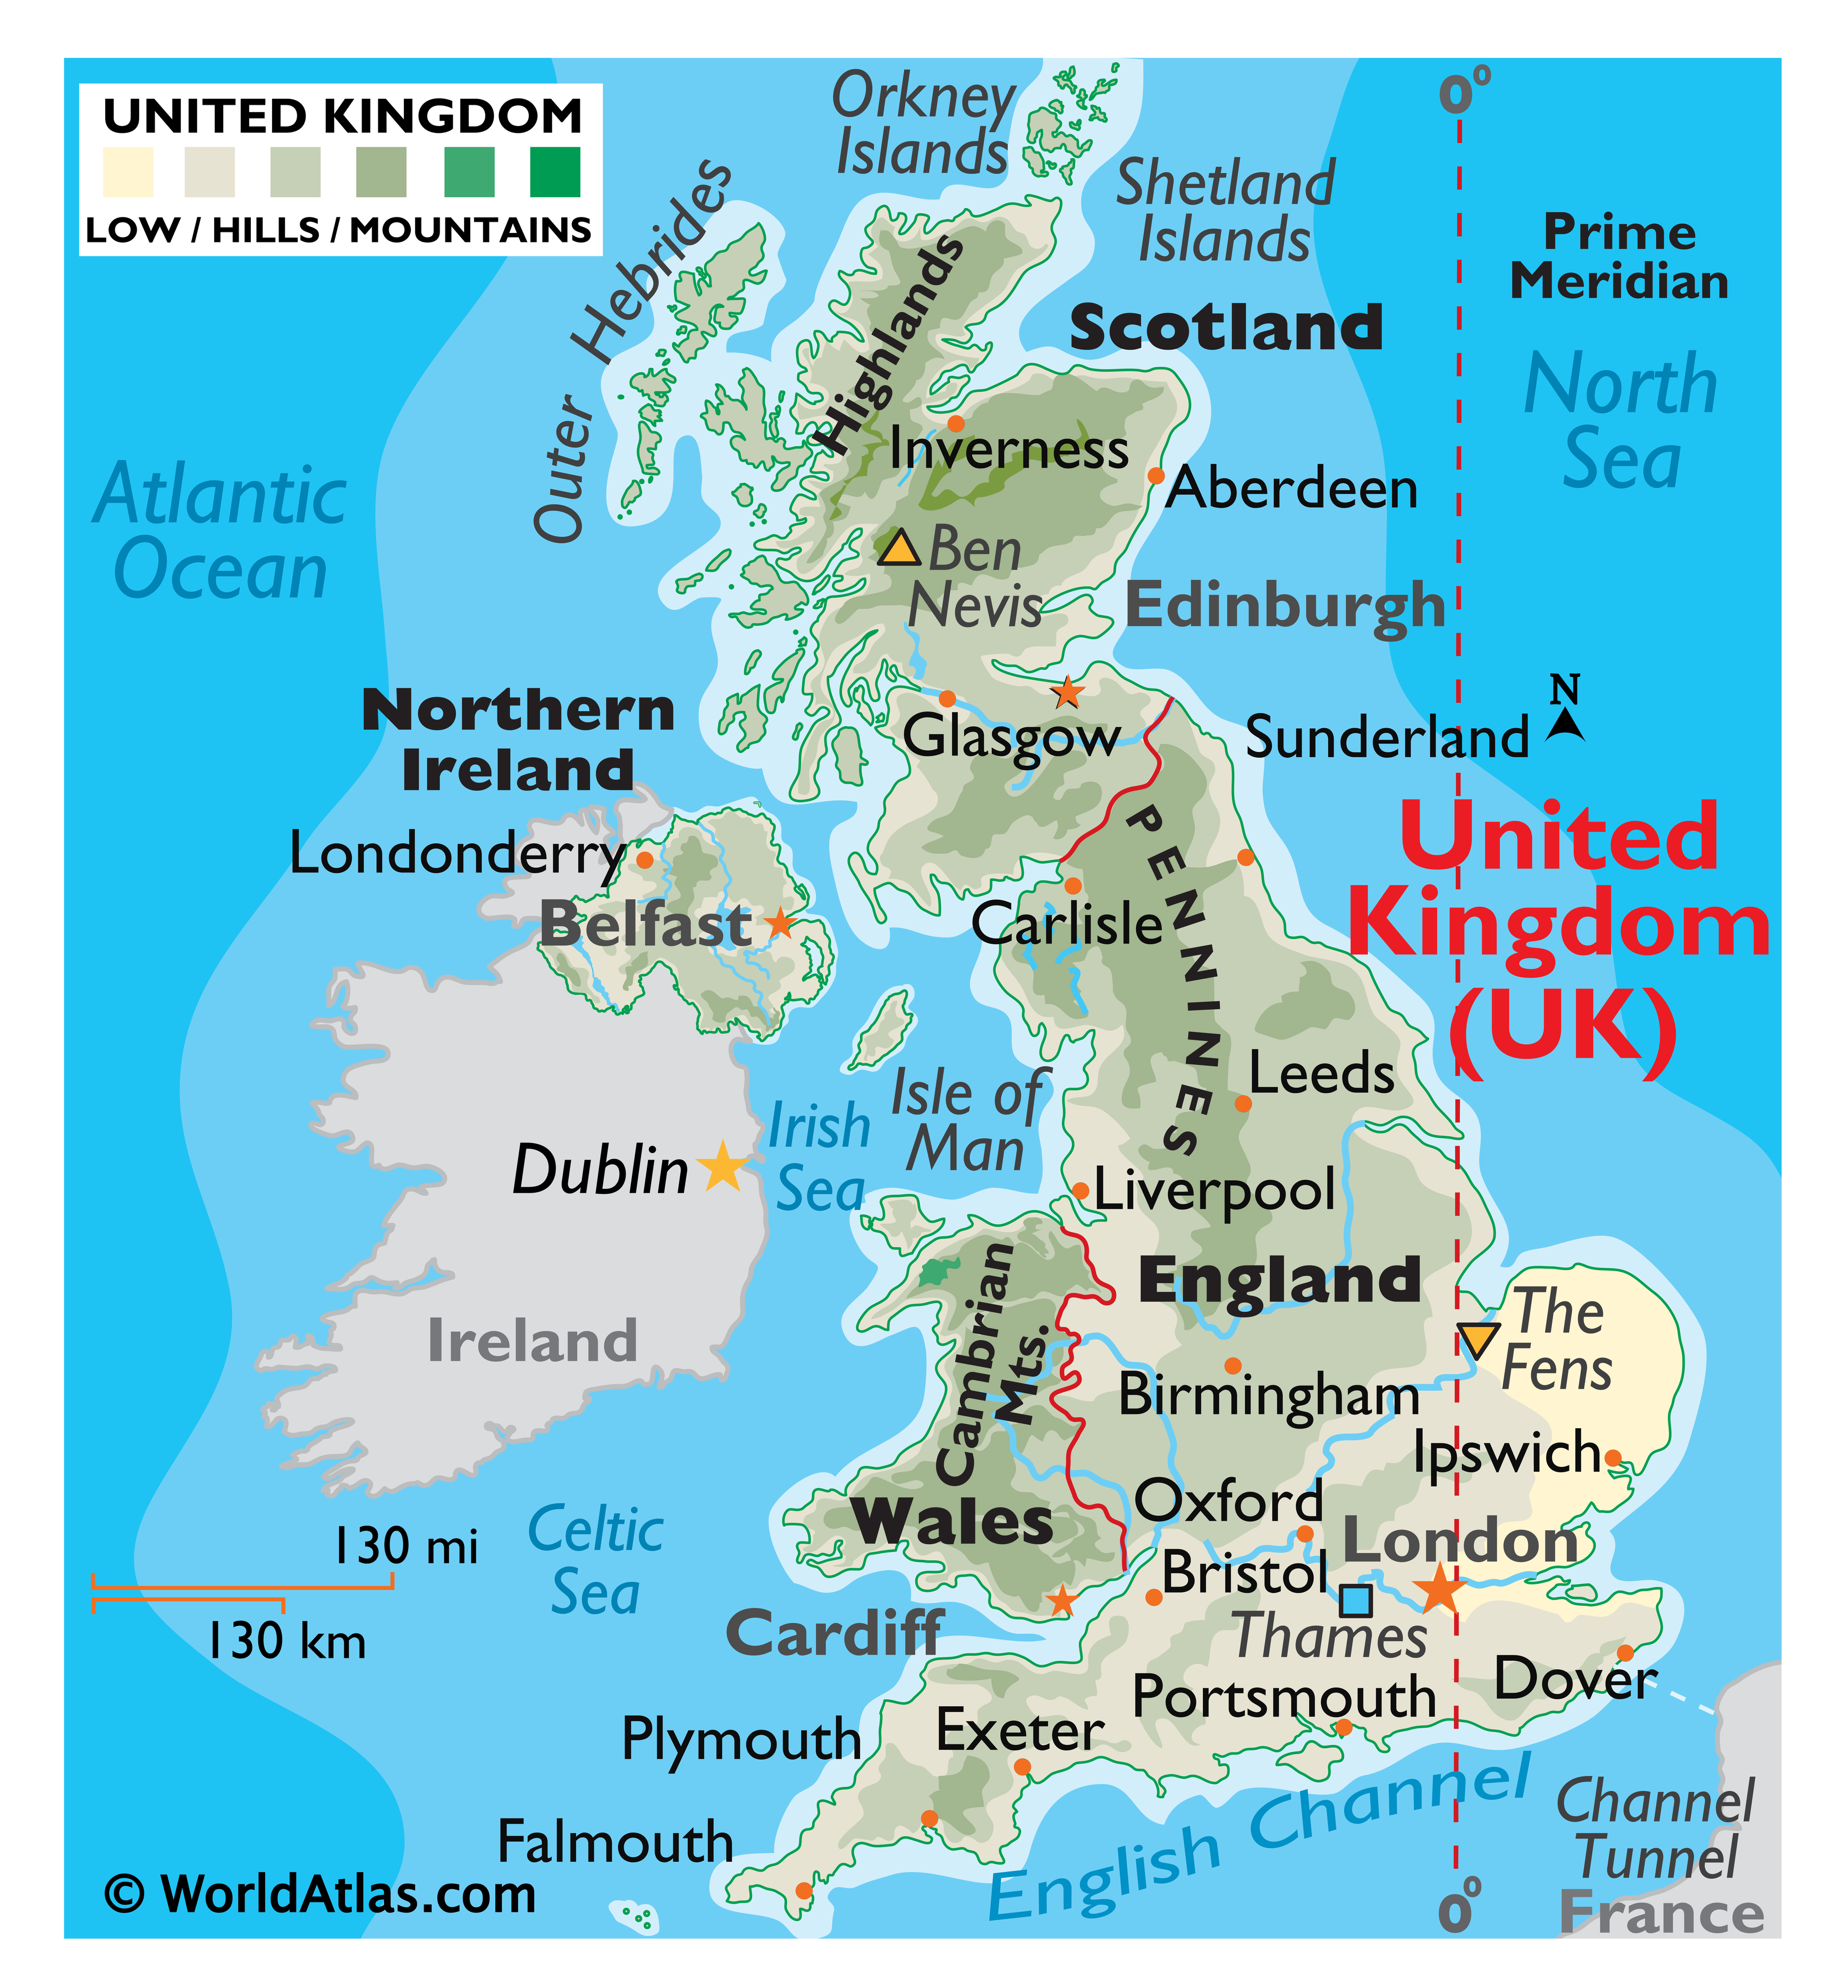
@lottabo_2025

Slide 3
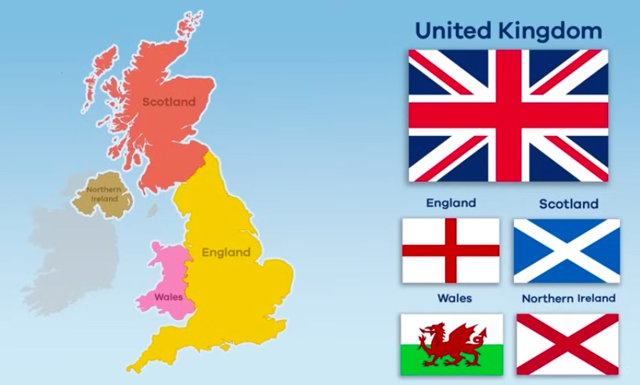
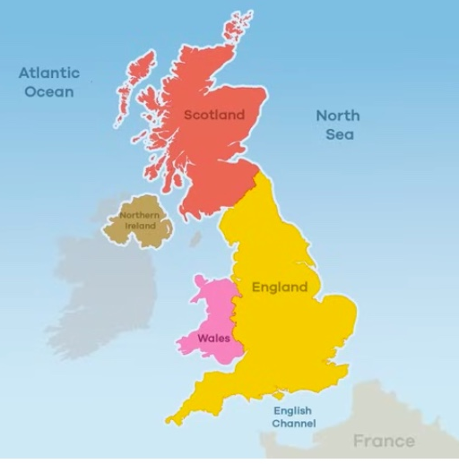

https://www.youtube.com/watch?v=5fyagkd97LQ
The Map – The Countries - The Flag
Use words from the wordlist to talk about the picture.
The United Kingdom
WORDLIST
islands
surrounded
ocean
sea
country
map
flag
capital city
language
weather
North
South
East
West
Cardiff London Edinburgh Belfast Dublin
@lottabo_2025

Slide 4
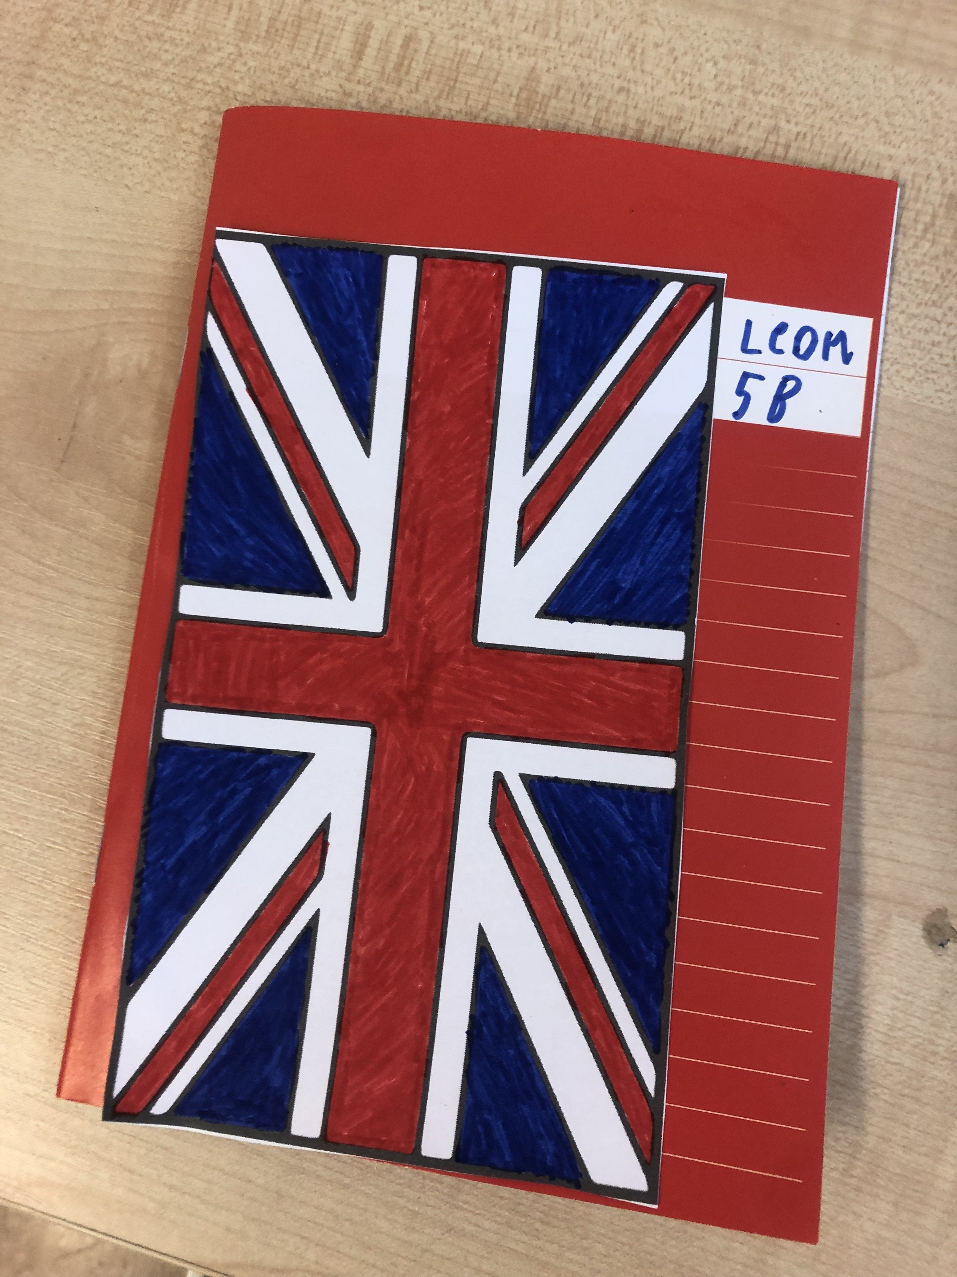
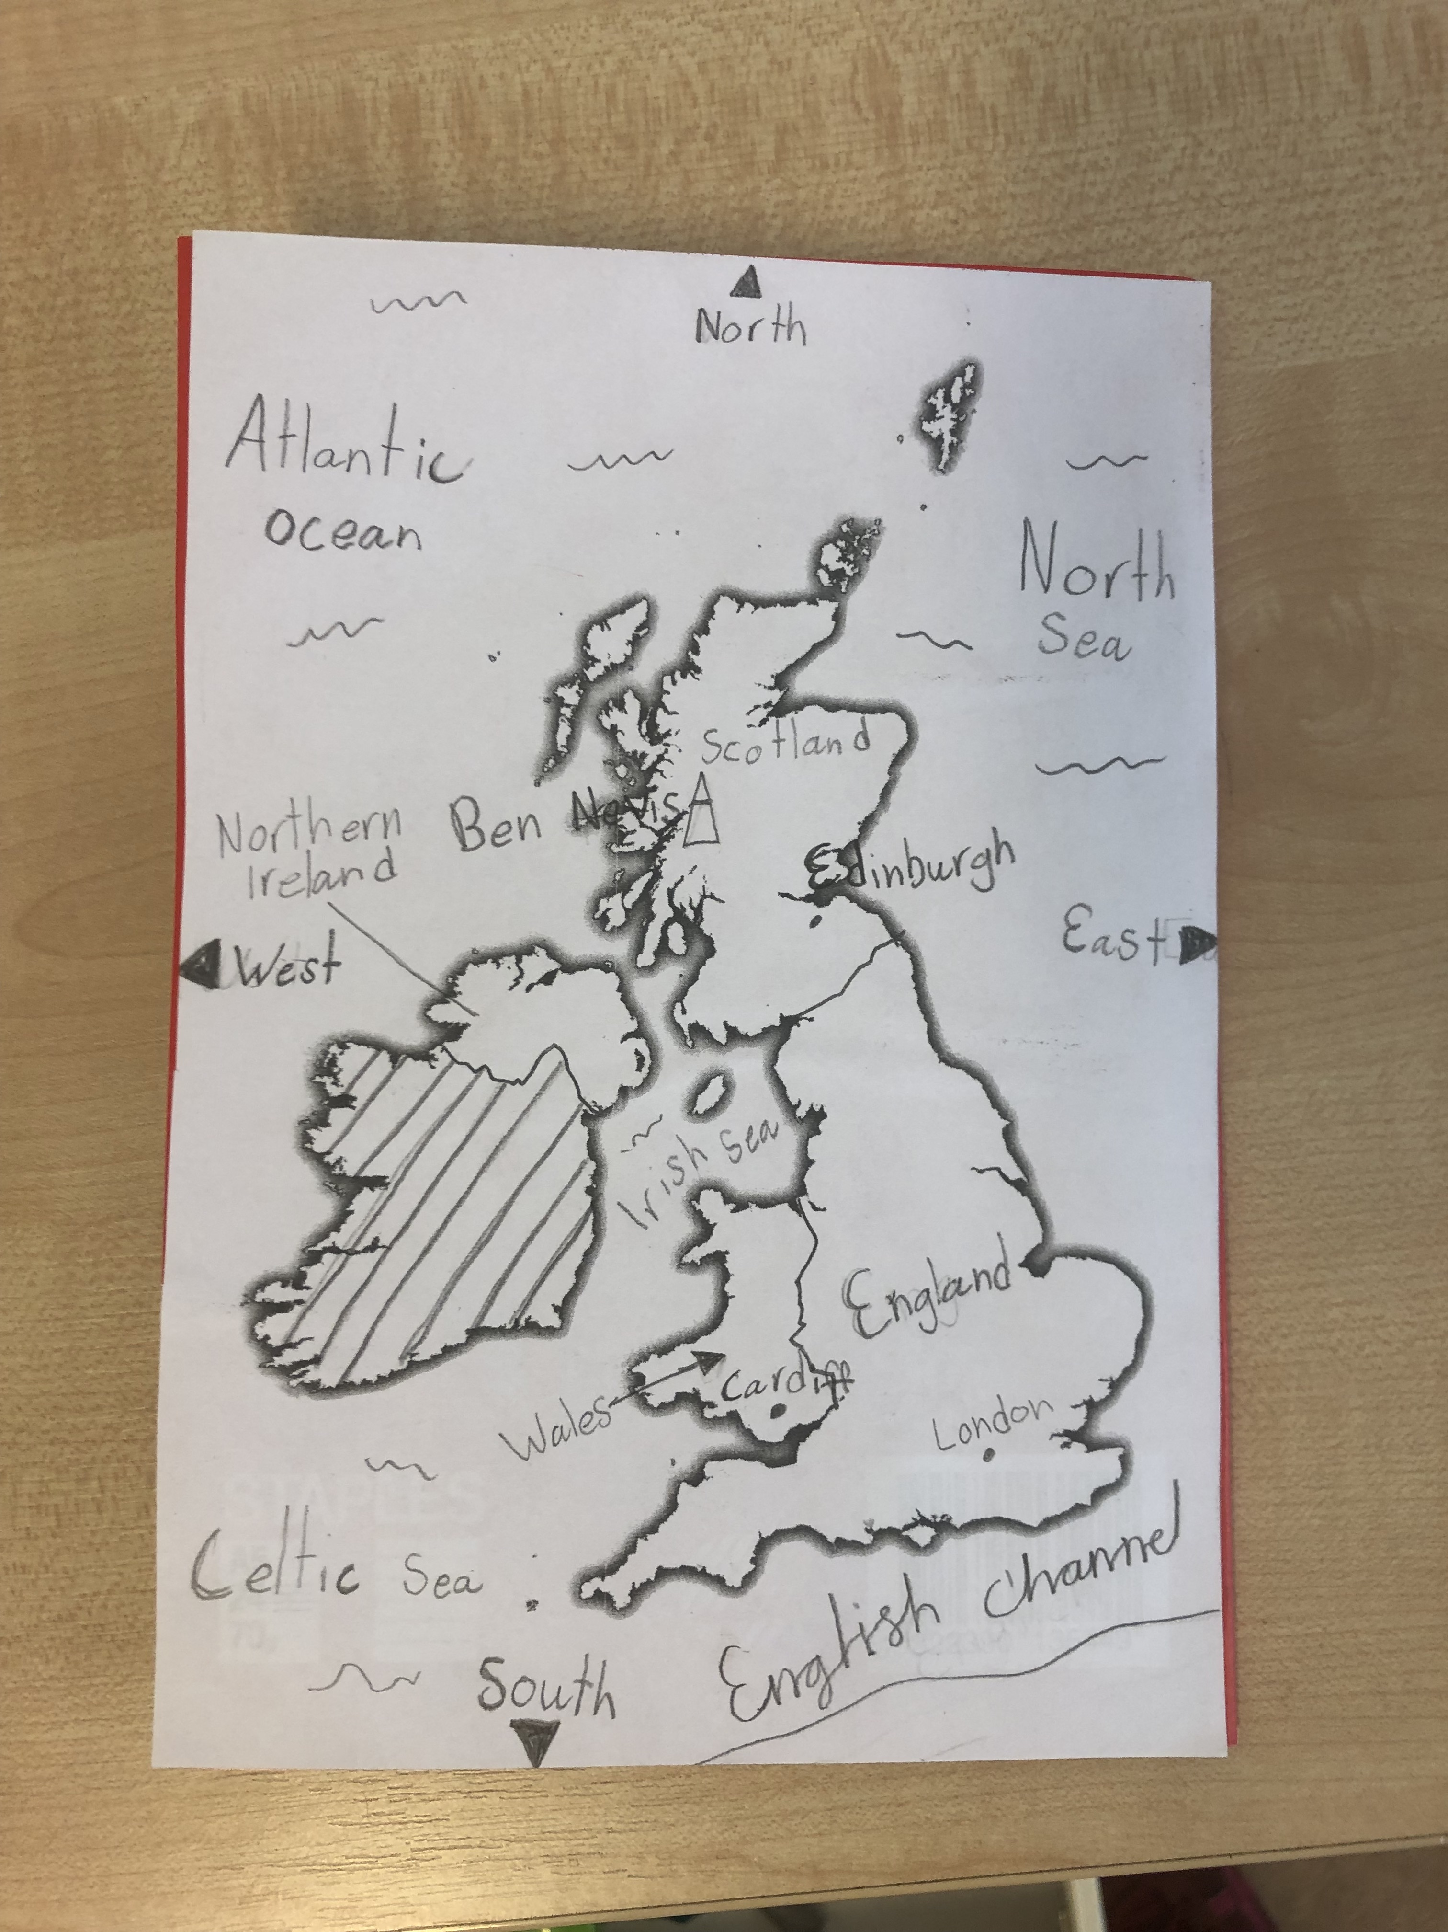
Your guide book!
@lottabo_2025

Slide 5

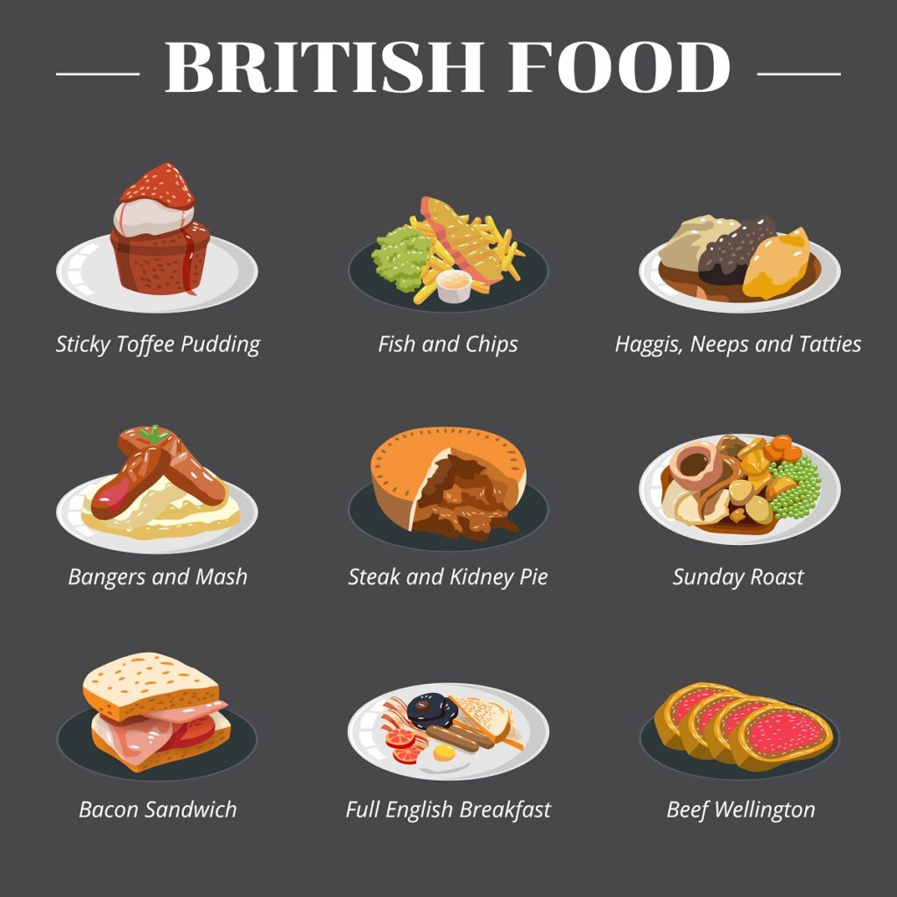
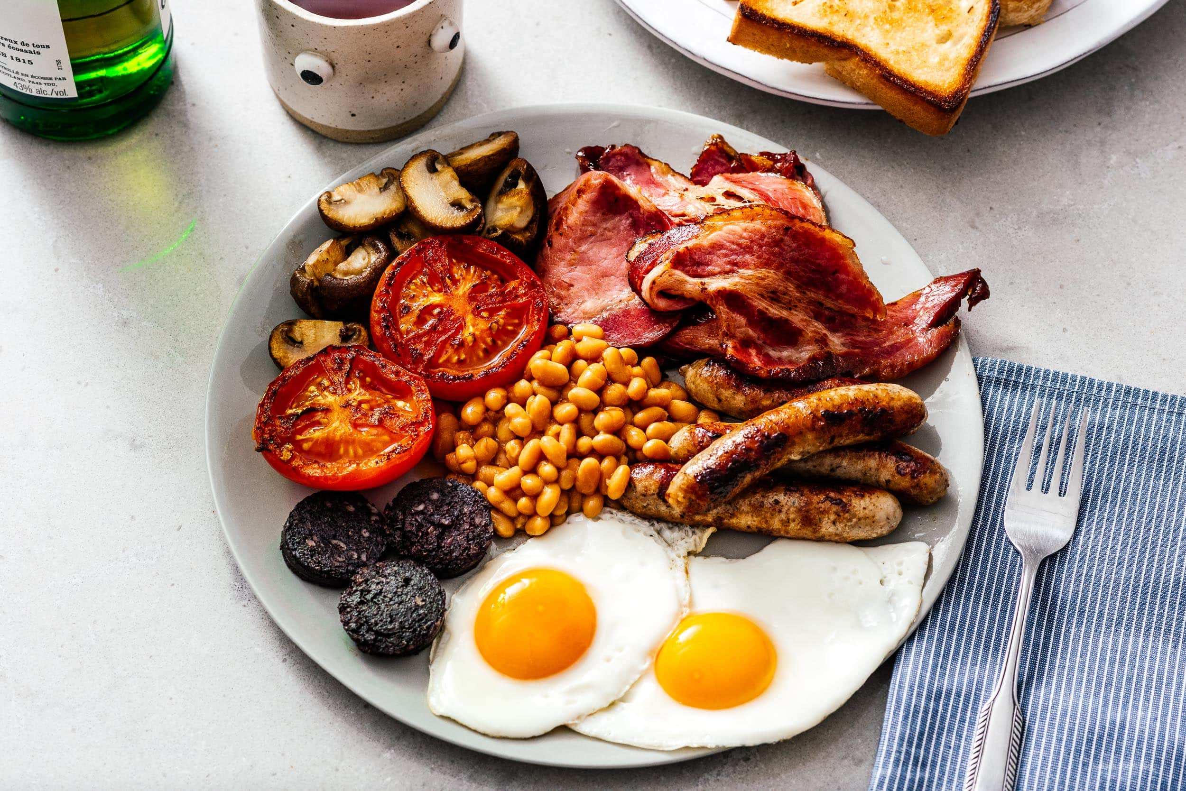
2. Facts about England
Country: England
Capital: London
Language: English
Population: 58.000.000 (UK 69.551.332)
Other large cities: Birmingham, Manchester,
Liverpool, Leeds.
Monarch: King Charles the 3rd.
Currency: Pound sterling (L)
Time zone: Greenwich Mean Time
Driving side: Left
Calling code: +44
Longest river: River Severn
Football: Premier League
Famous people: William Shakespeare, Charles Dickens, The Beatles, J K Rowling
Food: Fish and chips & Chicken Tikka Masala
Music: Ed Sheeran, Coldplay, Dua Lipa
WORDLIST
population
left side
monarch
King
Queen
Premier League
currency
river
famous
breakfast
sandwich
chips
sausage
toasted bread
singer
author
Full English Breakfast
@lottabo_2025

Slide 6
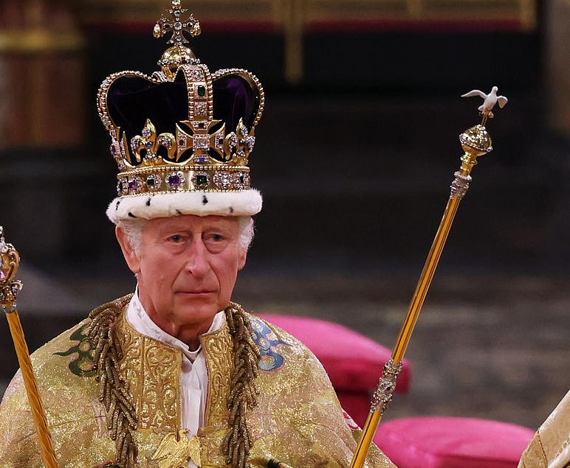
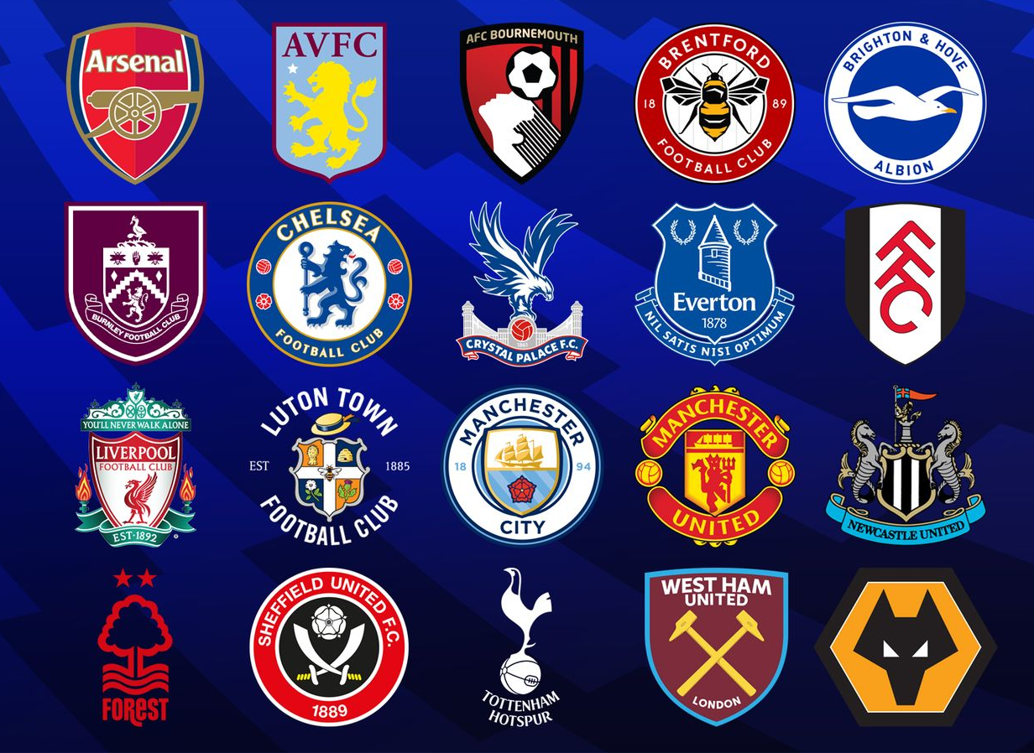
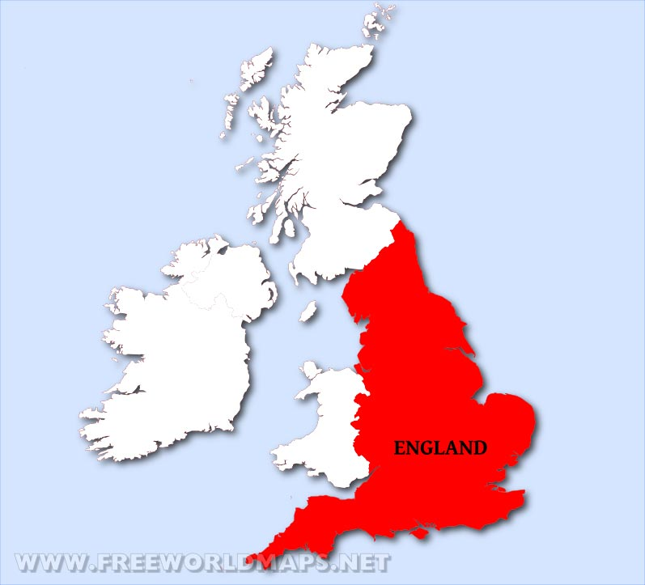
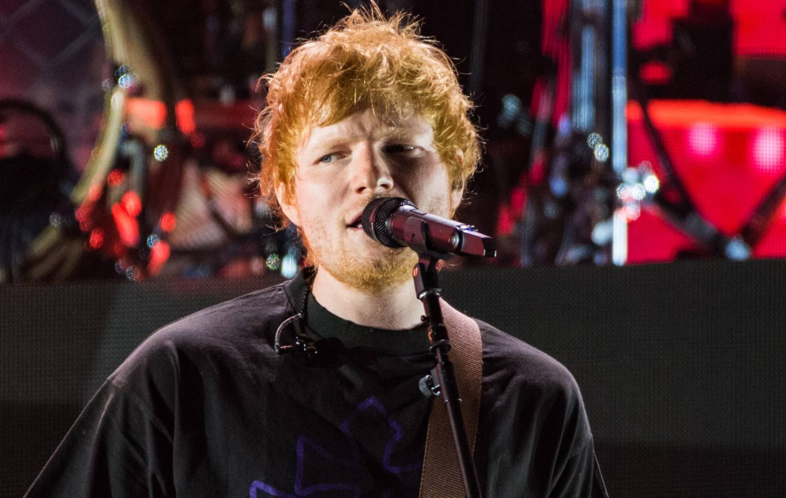
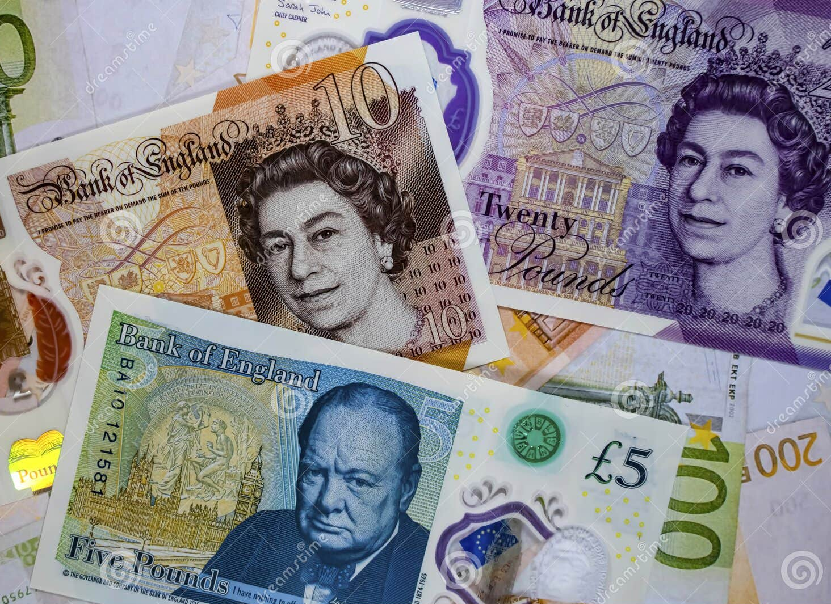
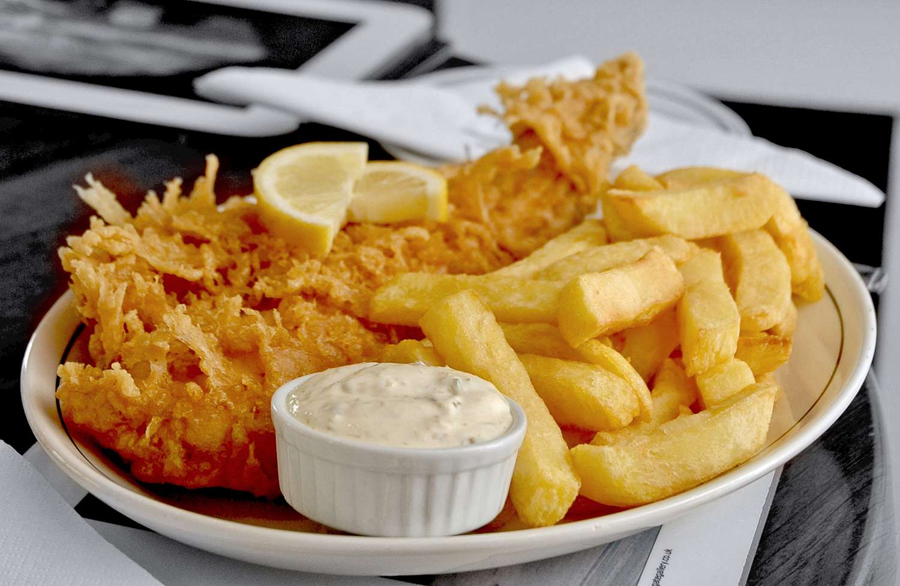
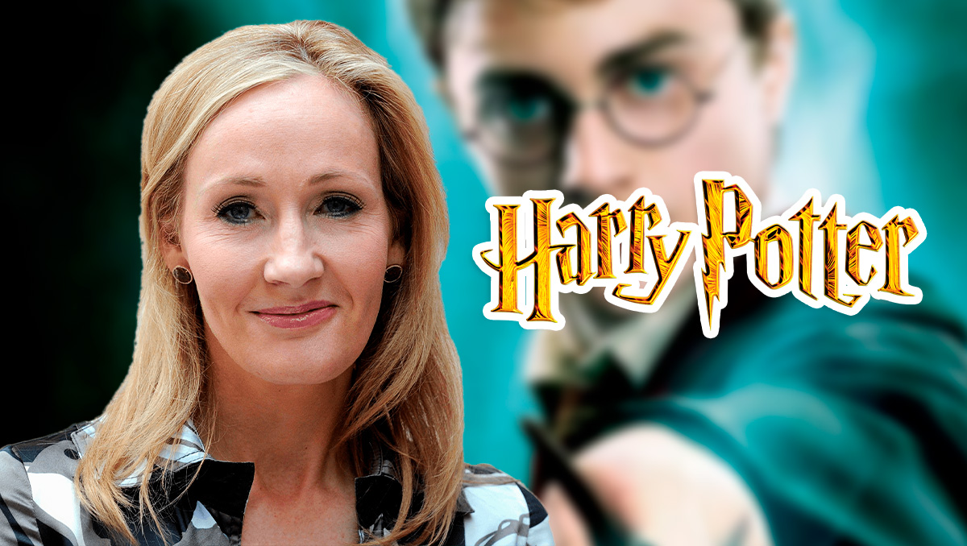
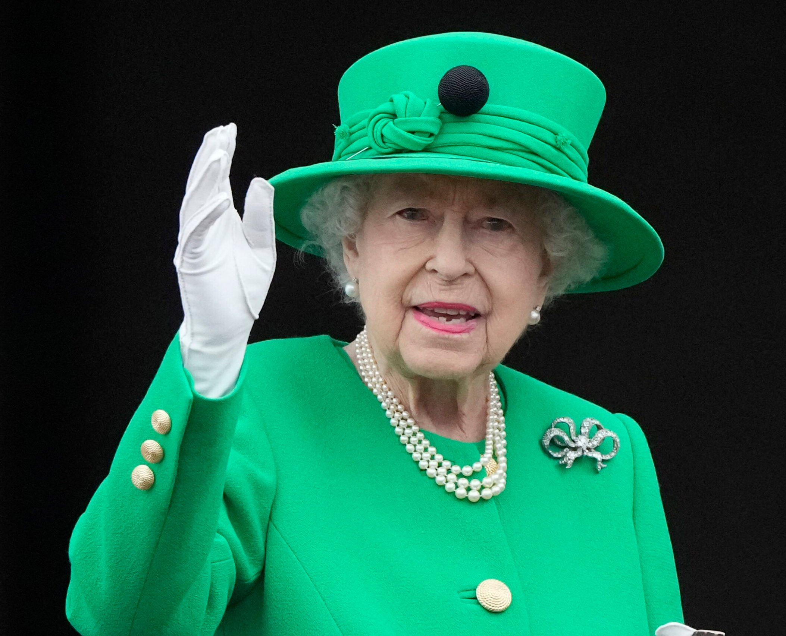
2. Facts about England
WORDLIST
population
left side
monarch
King
Queen
Premier League
currency
river
famous
breakfast
sandwich
chips
sausage
toasted bread
singer
author
@lottabo_2025

Slide 7
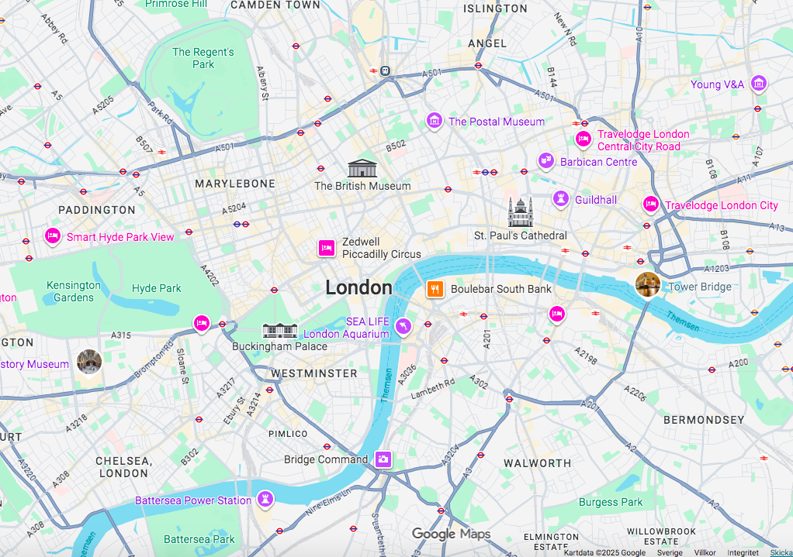
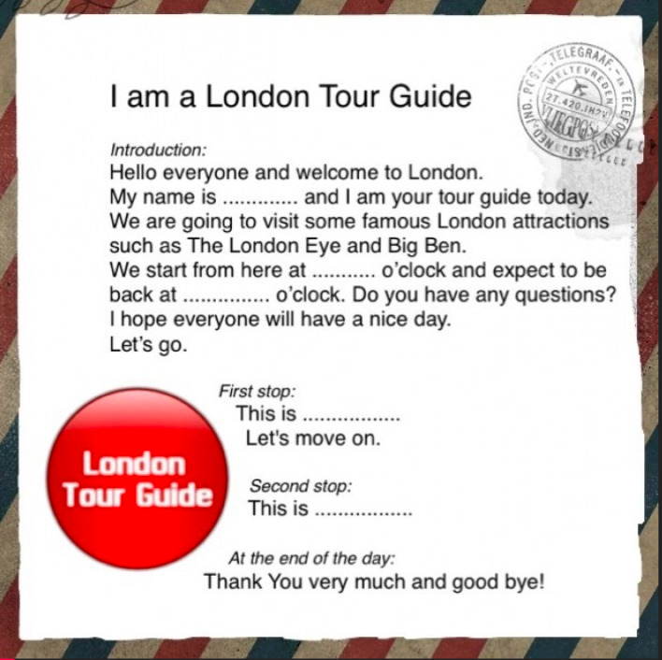
3. London
WORDLIST
street
park
lake
square
underground
bridge
train
area
tour guide
attractions
Big Ben
London Eye
Madame Tussauds
Hyde Park
Jack the Ripper
@lottabo_2025

Slide 8



























































London Zoo
Hyde Park
The Ritz Hotel
Harry Potter Museum
Madame Tussauds
Big Ben
Westminster Abbey
London Eye
Buckingham Palace
Trafalgar Square
Whitechapel
Tower of London
Tower Bridge
The Shard
Tate Modern
Millenium Bridge
St Paul's Cathedral
London Bridge
River Thames
London Waterloo
3. London
@lottabo_2025

Slide 9
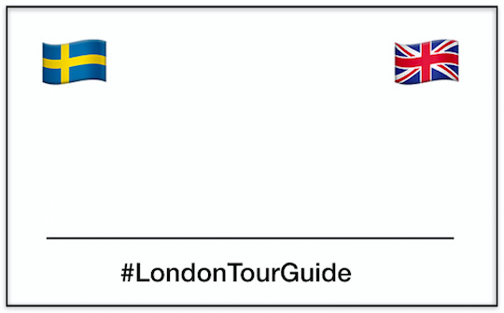
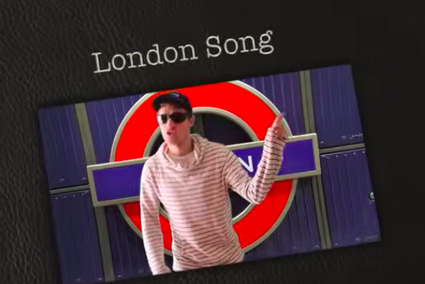
London rap song
@lottabo_2025

Slide 10
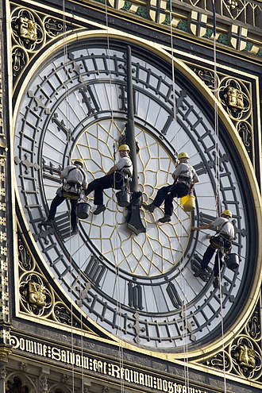
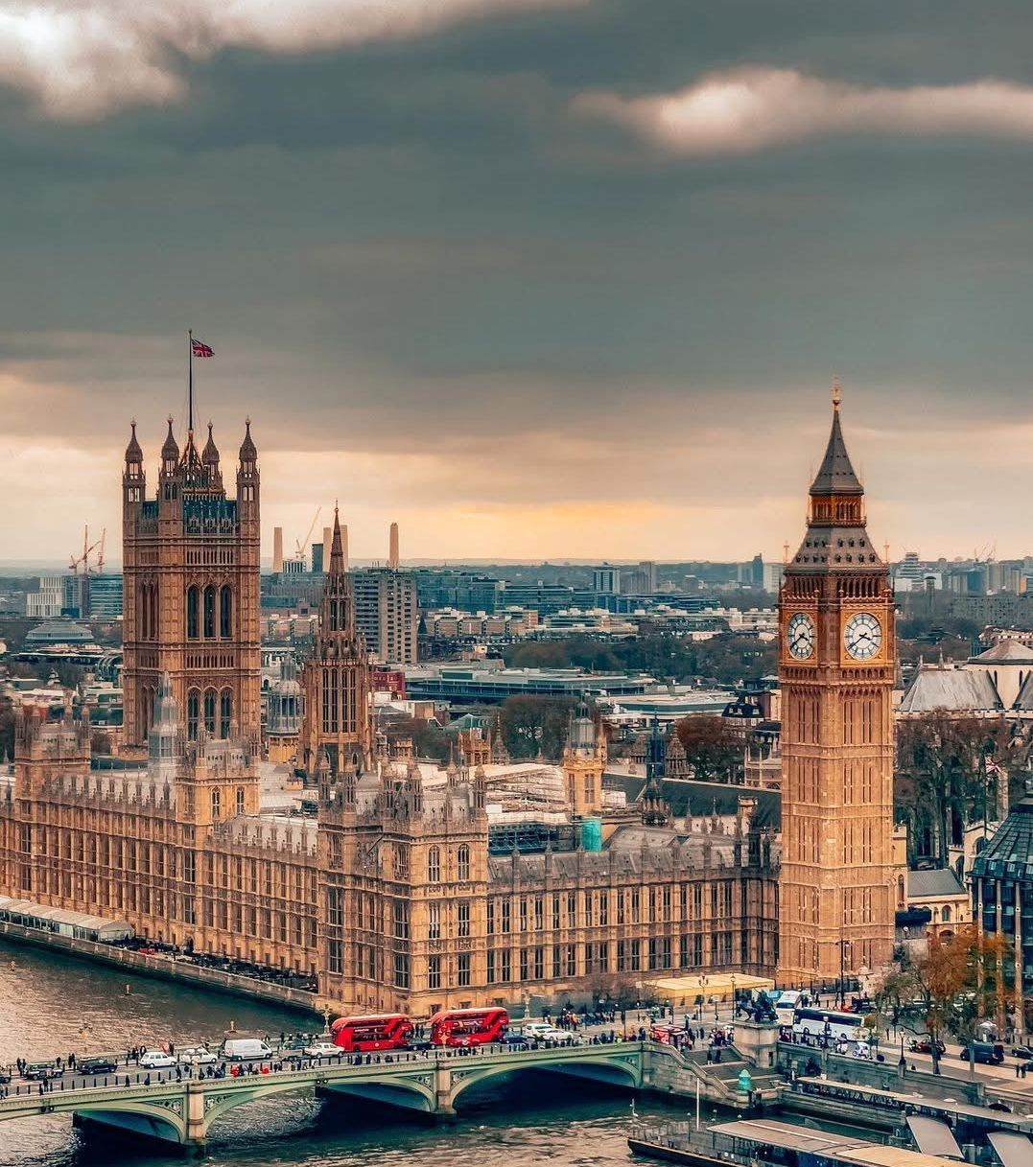

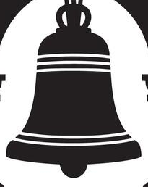
VisitLondon “Big Ben”
Youtube “What’s inside the Big Ben?”
BBC “Big Ben chimes”
4. Big Ben
Iconic landmark
Elizabeth Tower
The Houses of Parliament
Big Ben first rang on 31 May 1859.
The bell weighs 13,8 tons.
Four quarter bells.
Each dial is 7 metres in diameter.
They each contain 324 pieces of opalescent glass.
96 metres tall.
334 steps to climb up to the belfry.
399 steps to the Ayrton Light at the very top.
2017–2021 restoration.
WORDLIST
clock tower
massive bell
weighs
four clock faces
illuminated
chimes
tall
steps
landmark
dial
the north end of
the hour hand
the minute hand
How to draw “Big Ben” (easy)
How to draw “Big Ben” (difficult)
“Peppa Pig goes to London”
@lottabo_2025

Slide 11
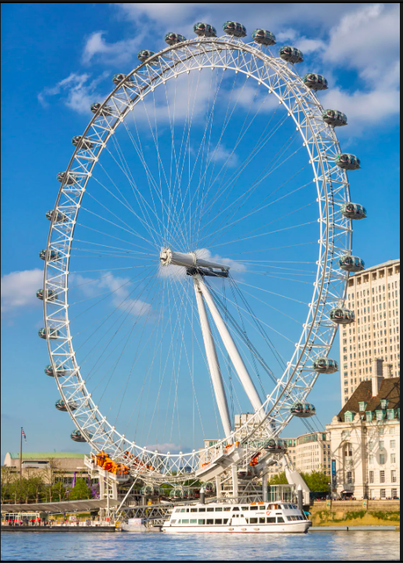
VisitLondon "London Eye
londoneye.com
Youtube "London Eye with Tim"
5. London Eye
360-degree view
135 metres
A diameter of 120 metres
Built to celebrate the millennium in 2000
32 high-tech glass capsules
A ride takes approximately 30 minutes
Each capsule can carry 25 people
Skip the queues with a fast-track entry ticket.
There is no 13th capsule as it is believed to be unlucky.
The London Eye can hold 800 people per revolution.
Since 2000 more than 70 million
The London Eye opens at 11am and closes at 6pm.
Child Ticket From £35.00 per ticket
Infant Ticket Free
Adult Ticket From £39.00 per ticket
Over three million visitors annually
WORDLIST
ferris wheel
millenium
capsules
ride
passenger
tour
panoramic view
ticket
queue
visitors
adult
child
open
close
am./pm.
Youtube "Minecraft"
London Eye 360
Youtube "London 2025 3 hour film"
Youtube "London film locations"
Youtube "Facts about London Eye"
@lottabo_2025

Slide 12
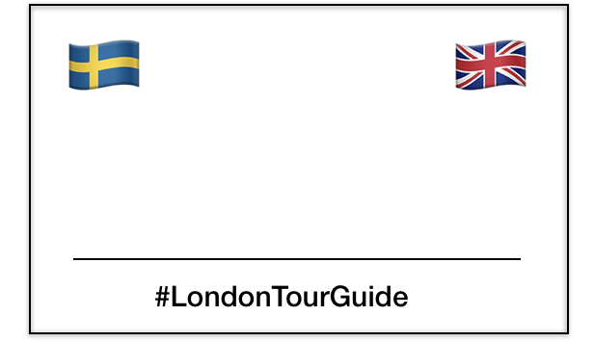
@lottabo_2025

Slide 13
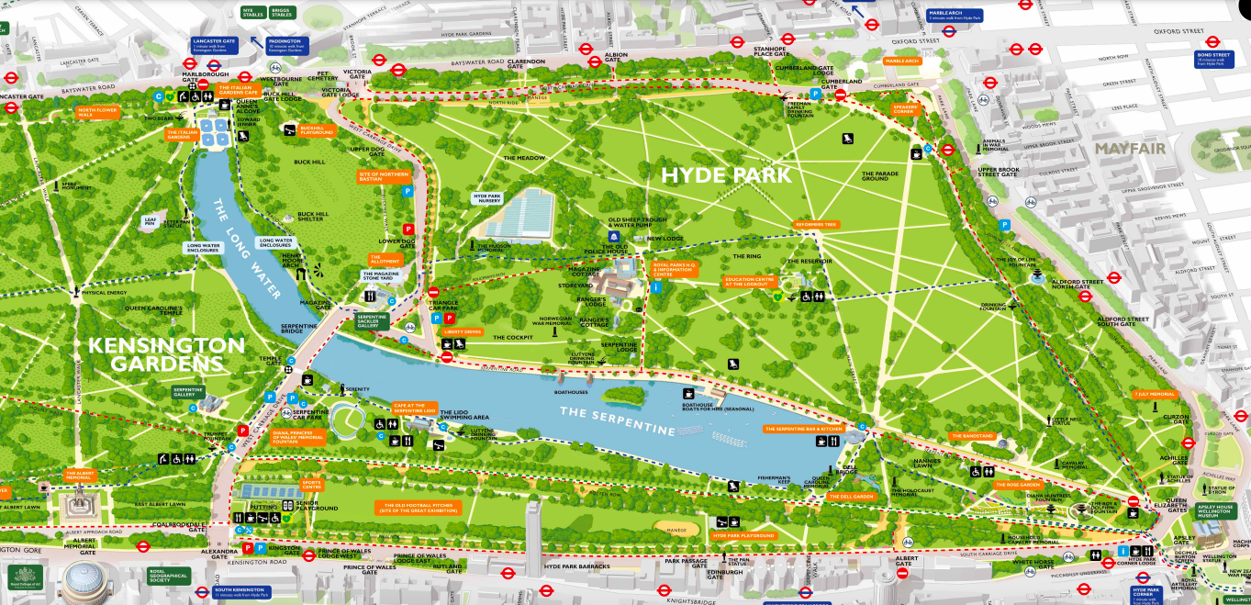
Royal Parks "Hyde Park"
VisitLondon "Hyde Park"
Youtube "A short guide to HP"
6. Hyde Park
Royal Park
Hyde Park & Kensington Gardens
The Serpentine
142 hectares
Public Park open from 5 a.m. until midnight.
The Grand Entrance
First flowers planted 1860
Animals
Activities; sports, walking, tennis, horse riding, swimming, picnic, boating.
To see; Speaker's Corner, The police station, Diana Memorial Fountain, Winter Wonderland.
Restaurants
WORDLIST
ll
park
gate
corner
lake
animals
lawn
midnight
playground
activities
toilets
concerts
restaurants
bars
royal
public
paths
@lottabo_2025

Slide 14
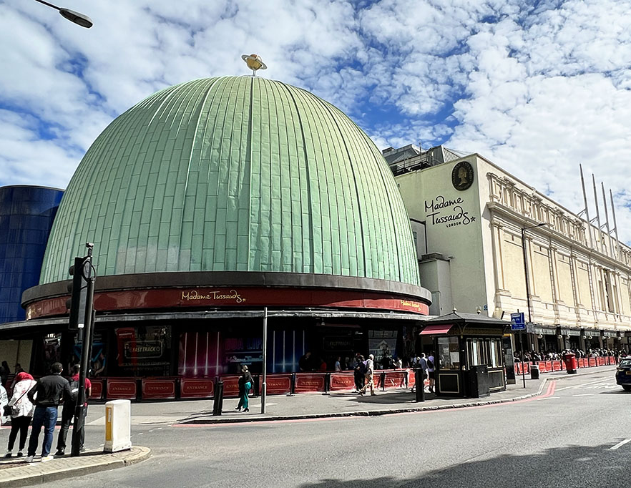
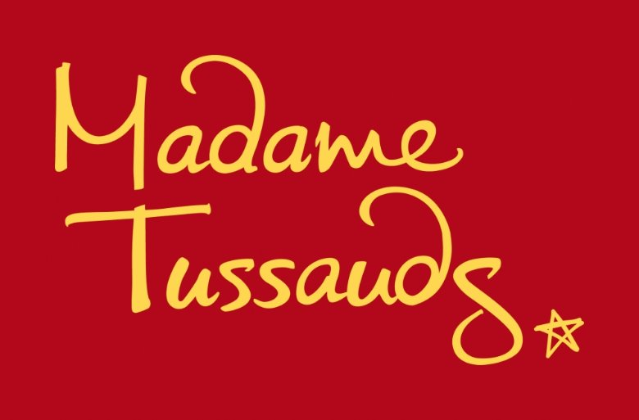
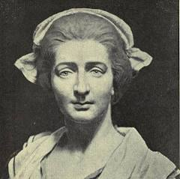
VisitLondon "Madame Tussauds"
madametussauds.com
Youtube "Making Lady Gaga"
7. Madam Tussauds
A museum full of life-sized wax figures.
Opened in 1835.
Marie Tussaud is the founder and a
French wax-sculptor (1761-1850).
Famous people and characters from all over
the world, like Spider-Man, Harry Potter,
Beyoncé and royal family members like
King Charles III and Prince William.
Artists spend months making the wax figures.
You can take selfies with your favorite stars.
“Spirit of London”, a section where you ride in a
black cab through scenes from London’s history.
Chamber of Horrors, where you learn about some
dark and spooky stories from the past.
Open seven days a week between 10am and 3pm.
Child Ticket From £26.00
Infant Ticket Free
Adult Ticket From £29.00
Over 2.5 visitors annually
WORDLIST
museum
ticket
Wax figures
celebrities
stars
founder
artists
sculpture
selfie
history
Other MT locations: Las Vegas, New York, Berlin, Prague, Singapore, Hong Kong, Dubai, Sydney.
@lottabo_2025

Slide 15
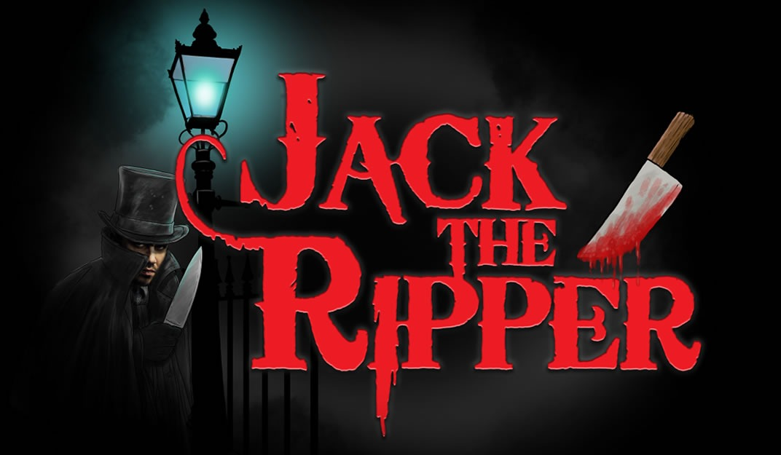
VisitLondon "Madame Tussauds"
madametussauds.com
Youtube "Making Lady Gaga"
8. Jack the Ripper
WORDLIST
museum
ticket
Wax figures
celebrities
stars
founder
artists
sculpture
selfie
history
London 1888.
The killing of five innocent women.
@lottabo_2025

Slide 16
VisitLondon "Jack the Ripper Walking Tour"
jacktheripper.org
Youtube "Jack the Ripper – Draw my Life"
8. Jack the Ripper
London, around 1888.
Jack the Ripper is a pseudonym.
A serial killer in Whitechapel.
Still unknown.
Five innocent women.
Mary Ann Nichols, August 31.
Annie Chapman, September 8.
Elizabeth Stride, September 30.
Catherine Eddowes, September 30.
Mary Jane Kelly, November 9.
Horrific knife attacks against poor people.
Prostitutes.
Police investigation.
Receiving letters.
Many suspects.
A man in a hat and a coat.
Aaron Kosmiski ?
WORDLIST
serial killer
murderer
victims
women
innocent
prostitutes
unknown
poor
area
letter
suspects
the ripper
corp
witness
coat
immigrants
@lottabo_2025

Slide 17
Welcome to London!
Time to make your own guide tour – with tourists!
Prepare your guide test:
Introduce yourself
First stop: ____________
Secon stop: ____________
Third stop: ______________
@lottabo_2025

